Slide 1

Job Market Analysis
PPROJECT TEAM ID: PTID-CDA-AUG-24-194

Slide 2
Objective
The main goal of this project was to analyze job market trends, process, and visualize a dataset consisting of 742 rows and 42 features. It sought to find out the job title, salary estimate, company rating, location, and skill set required for that job. It is expected that the result of each of the following functions will elicit thoughtful, insightful deductions that shall profit jobseekers and their recruiters.

Slide 3
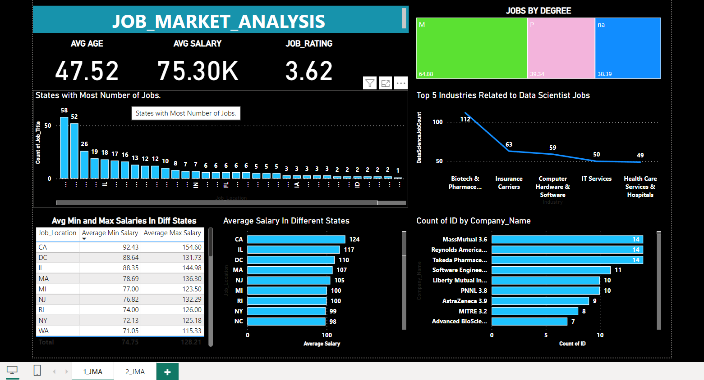
DashBoard Image
1st-Page

Slide 4
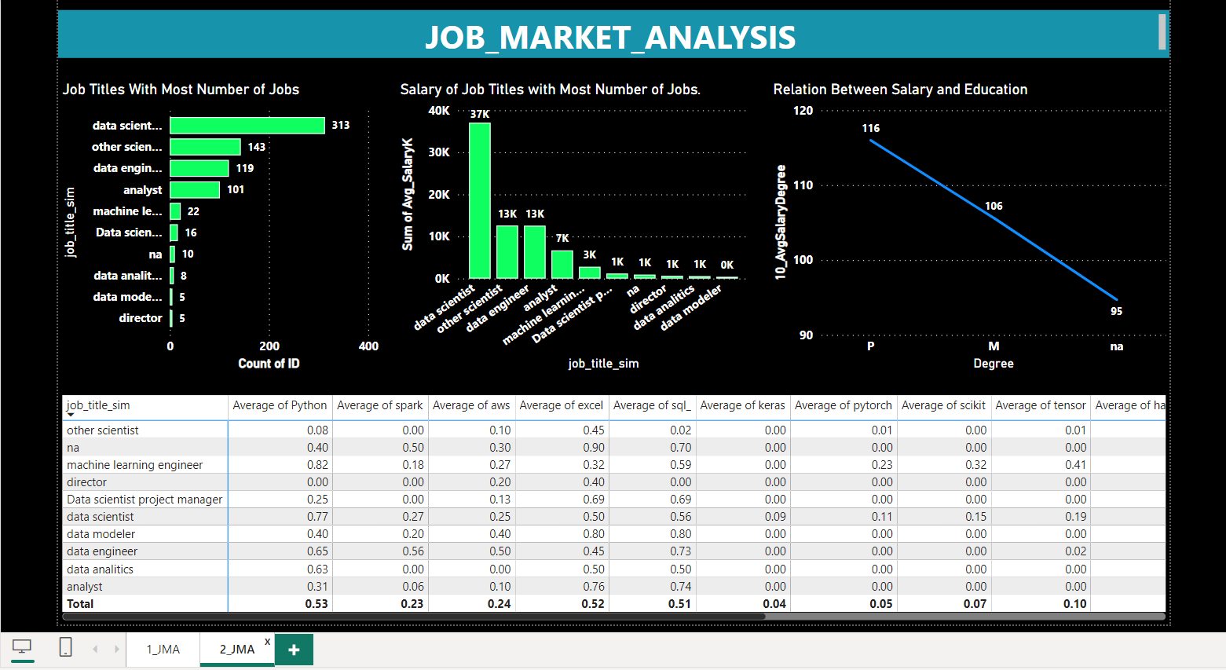
DashBoard Image
2nd Page

Slide 5
Tasks Completed
Task 1: Retrieving data from the database using the credentials provided. We were able to extract the dataset successfully using the provided database credentials. After that, cleaning and preparation of the dataset for analysis in Power BI had been done.
Task 2: States with Most Number of Jobs Using Power BI, we determined the states with the highest number of job postings. We could also spot a region with more employment opportunities than others, which would be very useful for any job seeker who is planning to relocate or target his job search.

Slide 6
Tasks Completion
Task 1: Retrieving data from the database using the credentials provided. We were able to extract the dataset successfully using the provided database credentials. After that, cleaning and preparation of the dataset for analysis in Power BI had been done.
Task 2: States with Most Number of Jobs Using Power BI, we determined the states with the highest number of job postings. We could also spot a region with more employment opportunities than others, which would be very useful for any job seeker who is planning to relocate or target his job search.

Slide 7
Tasks Completion
Task 3: Average Minimal and Maximal Salaries in Various States We have averaged the minimum and maximum salaries across states. This understanding given, regional salary trends are made available to the job seeker and to an employer for them to make well-informed decisions on compensation.
Task 4: Average Salary Across Different States Other than deciding on minimal and maximal salary, we calculated the average salary per state. This further drilled down the insight on how salaries varied geographically and gave importance to high or low average compensation per state.

Slide 8
Tasks Completion
Task 5: Top 5 Industries with Maximum Number of Data Science Related Job Postings Top 5 industries with the most Data Science-related job advertising: This gave us an insight into growing demand for professionals in the data field and knowledge on the leading sectors.
Task 6: Companies with the Maximum No. of Job Openings By analyzing the number of job openings by company, we are able to identify which organizations are hiring the most. Such insight would be very valuable to job seekers targeting companies most in need of their talents.

Slide 9
Tasks Completion
Task 7: Job Titles with Most Number of Jobs We found the most common job titles across the dataset. Knowing what roles are in demand can help job seekers adjust their skills and experiences to market needs.
Task 8: Salary of Job Titles with Most Number of Jobs The average salary was taken for each of the most common job designations. Again, this kind of analysis gives a clean view of how key roles are compensated and guides what to expect in terms of salary.

Slide 10
Tasks Completion
Task 9: What Type of Skill Sets Companies Look for in Each Job Title We evaluated the job skills associated with each job title. This gave us full insight into the kind of qualifications that employers were seeking. This is useful information to the job seekers so that they structure their resume and also to the employer so that they could fine-tune the job description.
Task 10: Average Salary vs. Education We have looked at what relationship education levels have to average salary. Such analysis indicates the role that education may play in earning potential, or how increased qualifications can mean better compensation.

Slide 11
Tasks Completion
Task 11. Explore All Features and Obtain Several Insights Analyzing all the available features, we have been able to derive some useful insights from it, of which some include the following: 1.Regional job market trends according to job postings and salary data. 2.Industry-specific demand in the field of Data Science. 3.Company hiring patterns across sectors. 4.The role of education in setting salary levels.
Task 12: Visualize the data using Power BI, and insights with suggestions must be derived. With the Power BI tool, we created interactive visualizations, hence making data interpretation very easy. Key insights were visualized with bar charts, line graphs, and heat maps. The suggestions that were made to the company are as follows: 1.The intensity of recruitment needs to be increased in states that have high job openings but relatively lower salary competition. 2.Tailor job descriptions to match the skills in demand. 3.Specialize in industries where demand for Data Science roles is particularly high.

Slide 12

Conclusion
There was a dashboard displaying all trends in the job market related to the availability of jobs, salary distribution, and the required skills across several states, industries, ratings ,salaries and companies. The information will, therefore, go a long way in helping job seekers focus on high-demand areas and tailor their qualifications in regard to the market. Employers would also adjust the recruitment strategy accordingly, with the goal of making sure salary offerings are reasonable enough to pick the best talent.

Slide 13

Thank You

